Slide 1

Event-Driven Malicious URL Extractor
2021-085
10.03.2021

Slide 2




Team Members
S. W Sajeth Jonathan
IT18071412
Team Leader
Wishvajith B.L.D.V​
IT18032666
Team Member
Ramanayaka A. M​
IT18021912
Team Member
Renu Harshatha A.
IT18034400
Team Member
10.03.2021

Slide 3
Introduction
10.03.2021

Slide 4
4.66 Billion
Internet Users
Jan 2021
https://datareportal.com/global-digital-overview
10.03.2021

Slide 5
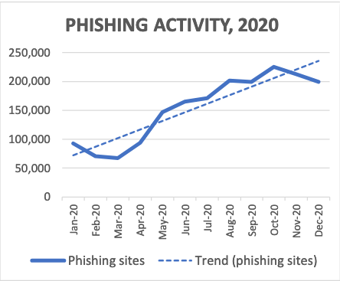
22% of data breaches involved Phishing*
APWG 2020 Q4 Report
*Verizon 2020 DBIR Report
10.03.2021

Slide 6
Research Problem
Event-driven System
Scalability
Finding URLs related to any global/local event for organizations to use as a blocklist
Adaptability of the system to change according to trending events.
10.03.2021

Slide 7
Research Problem
Classification Model
Feature Reduction
Machine Learning Models are used abundantly but sacrifices scalability and time as a trade-off
Identifying the correct features needed to build an efficient system
10.03.2021

Slide 8

Research Gap
Papers | Scalability | Accuracy | Classification of URLs | High rate of detection/efficiency | Ability to sort through keywords / Events | Classification of Scenarios
Research A [1]
Research B [2]
Research C [3]
Proposed Solution
10.03.2021
Notes:
[1] I. M. M. A. R. A. H. L. N. S. a. A. A. G. Mohammad Saiful, "Detecting Malicious URLs Using Lexical," in University of New Brunswick, Fredericton, NB, Canada, Fredericton, 2016.
[2] S. S. Vishal A. Kharde, "Sentiment Analysis of Twitter Data: A Survey of Techniques," International Journal of Computer Applications (0975 – 8887), vol. Volume 139, no. 11, p. 15, 2016.
[3] E. B. O. D. B. D. Ozgur Koray Sahingoz, "Machine learning based phishing detection from URLs," Expert Systems With Applications, 2019.

Slide 9
Research Objectives
Ensemble Model
Feature Reduction
01
02
Improve accuracy without decreasing performance
Reduce dimensionality of the extracted features
Event-driven System
Scalability
03
04
To detect attacks early in the life cycle
Scales the system when increase in URLs and keywords.
10.03.2021

Slide 10
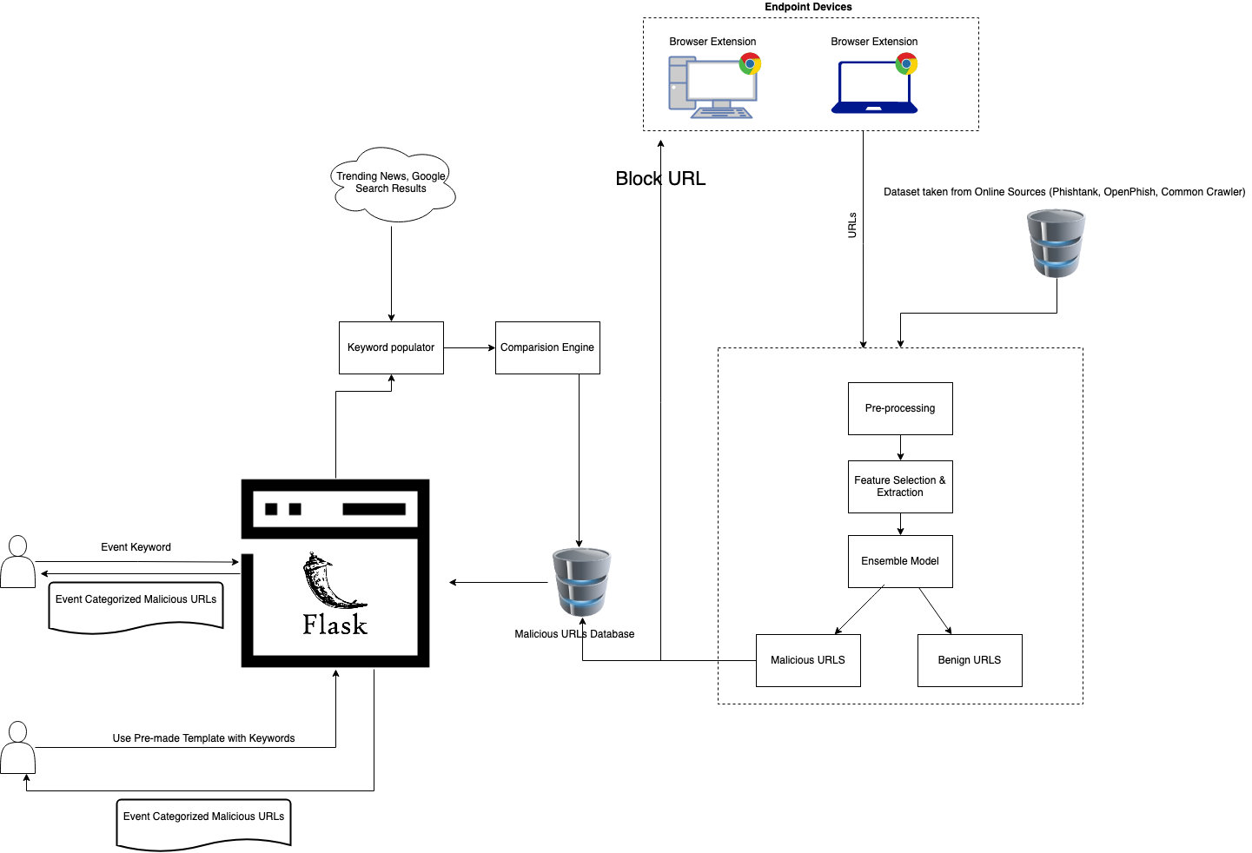
Overall System Diagram
10.03.2021

Slide 11
Our Contributions
10.03.2021

Slide 12
S. W Sajeth Jonathan IT18071412
IT18071412 | S.W Sajeth Jonathan | 2021-085 10.03.2021

Slide 13
Introduction
IT18071412 | S.W Sajeth Jonathan | 2021-085 10.03.2021

Slide 14
Background
Phishing attack consists of 4 phases [1]
Attacker prepares the webpage
Victim is tempted to click the link
1
2
3
4
Delivers it to the masses
Victim is manipulated in disclosing credentials/ download malware
IT18071412 | S.W Sajeth Jonathan | 2021-085 10.03.2021

Slide 15
Background
Malicious URL
Phishing
Drive by Downloads
Spam
Maclious URLs Types [2]
IT18071412 | S.W Sajeth Jonathan | 2021-085 10.03.2021

Slide 16
Research Gap
Papers | Scalability | Accuracy | Classification of URLs | High rate of detection/efficiency | Ability to sort through keywords / Events | Classification of Scenarios
Research A [11]
Research B [12]
Research C [13]
Proposed Solution
IT18071412 | S.W Sajeth Jonathan | 2021-085 10.03.2021
Notes:
[1] I. M. M. A. R. A. H. L. N. S. a. A. A. G. Mohammad Saiful, "Detecting Malicious URLs Using Lexical," in University of New Brunswick, Fredericton, NB, Canada, Fredericton, 2016.
[2] S. S. Vishal A. Kharde, "Sentiment Analysis of Twitter Data: A Survey of Techniques," International Journal of Computer Applications (0975 – 8887), vol. Volume 139, no. 11, p. 15, 2016.
[3] E. B. O. D. B. D. Ozgur Koray Sahingoz, "Machine learning based phishing detection from URLs," Expert Systems With Applications, 2019.

Slide 17
Background
Machine Learning
Deep Learning
Support Vector Machines (SVMs)
kNNs
Naïve Bayes
Logistic Regression
AdaBoost
Random Forest
Deep Neural Networks (DNNs) [4] Convolutional Neural Networks (CNNs) [4] Deep Belief Networks (DBNs) [5]
Long-Short Term Model (LSTM) [6]
Recurrent Neural Networks [7]
IT18071412 | S.W Sajeth Jonathan | 2021-085 10.03.2021

Slide 18
Background
Machine Learning
Ensemble modeling is a process where multiple diverse models are created to predict an outcome, either by using many different modeling algorithms or using different training data sets.
Recurrent Neural Networks (RNNs) + Convolutional Neural Networks (CNNs) [7]
Artificial Neural Network (ANN) + K-Nearest Neighbors (KNN) + Decision Tree (C4.5) + Random Forest Classifier (RFC) [10]
Long-Short Term Memory [LSTM] + Convolutional Neural Networks (CNNs) [7]
Monotone Multi-Layer Perceptron Neural Network, Multi-Layer Perceptron, Neural Networks [9]
IT18071412 | S.W Sajeth Jonathan | 2021-085 10.03.2021
Notes:
Vijay Kotu, Bala Deshpande PhD, in Predictive Analytics and Data Mining, 2015 .3.4 Ensemble Modeling
Ensemble modeling is a process where multiple diverse models are created to predict an outcome, either by using many different modeling algorithms or using different training data sets.

Slide 19
Background
Events Spawning Malicious URLS
Throughout the COVID-19 outbreak, malicious attacks have become more pervasive and damaging than ever. [3]
IT18071412 | S.W Sajeth Jonathan | 2021-085 10.03.2021
Notes:
Vijay Kotu, Bala Deshpande PhD, in Predictive Analytics and Data Mining, 2015 .3.4 Ensemble Modeling
Ensemble modeling is a process where multiple diverse models are created to predict an outcome, either by using many different modeling algorithms or using different training data sets.

Slide 20
Research Gap
Using ensemble models for Malicious URL detection is an emerging domain in which further capabilities and models can be explored
There is no publicly available system to classify malicious URLs based on events
IT18071412 | S.W Sajeth Jonathan | 2021-085 10.03.2021

Slide 21
Research Question
Which ensemble model will give adequate accuracy without trading too much in perfomance?
How to collect training and testing data effectively?
How to make the user interface intuitive to collect Event-based Malicious URLs ?
IT18071412 | S.W Sajeth Jonathan | 2021-085 10.03.2021

Slide 22
Objectives
Main Objective
Experiment and test combinations of various ML/DL models to find an effective ensemble model
Bidirectional LSTM + CNN [7]
IT18071412 | S.W Sajeth Jonathan | 2021-085 10.03.2021

Slide 23
Objectives
Sub Objectives
Build the webite using Python Flask Framework to collect event-based phishing URLs to detect malicious links early in the attack lifecycle
Feature to input Keywords
Export Event-based databases in CSV Format
IT18071412 | S.W Sajeth Jonathan | 2021-085 10.03.2021

Slide 24
Objectives
Sub Objectives
Collect Training and Testing data from publicly available sources
OpenPhish
PhishTank
Common Crawler
Alexa
IT18071412 | S.W Sajeth Jonathan | 2021-085 10.03.2021

Slide 25
Research Methodology
IT18071412 | S.W Sajeth Jonathan | 2021-085 10.03.2021

Slide 26
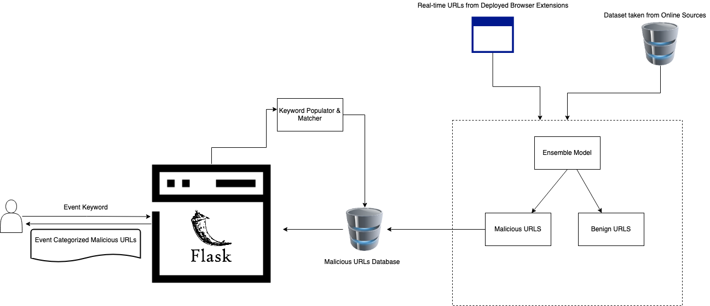
System Diagram
IT18071412 | S.W Sajeth Jonathan | 2021-085 10.03.2021

Slide 27





Technologies Techniques
Ensemble Modeling using Machine Learning and Deep Learning
IT18071412 | S.W Sajeth Jonathan | 2021-085 10.03.2021

Slide 28
System, Personnel and Software Specificaton Requirements
System Requirements
Desktop OS Platform Any OS with supported Browser (Google, Firefox)
API
Python API on TensorFlow
Coding Platform
Visual Studio Code
Jupyter Notebook
IT18071412 | S.W Sajeth Jonathan | 2021-085 10.03.2021

Slide 29
System, Personnel and Software Specificaton Requirements
Software Specification Requirements
Functional Requirements
The Ensemble model should be able to classify Malicious URLs effectively with a low false positive rate without compromising performance
The website must provide an easy interface for the user to collect Malicious URL datasets
Non-Functional Requirements
Accessiblity
Perfomance
Scalability
IT18071412 | S.W Sajeth Jonathan | 2021-085 10.03.2021

Slide 30
System, Personnel and Software Specificaton Requirements
Datasets
Malicious URLs for Training and Testing from PhishTank, OpenPhish
Benign URLs for Training and Testing from Alexa and Common Crawler
IT18071412 | S.W Sajeth Jonathan | 2021-085 10.03.2021

Slide 31
WBS
Event-Driven Malicious Extractor
Initiation
Planning
Design
Implementation
Closeout
Creation of Project Charter
Creation of Project Proposal
Event-driven system modeling
Ensemble model usages and accuracy
Setting up Dev Environment
Wireframes UI for webpage
Training and Testing ML Algorithms
Training and Testing DL Algorithms
Training an Testing combinations of ML/DL models to come up with an ensemble model
Building Website using Flask
Host the application and run it
Final Presentation
System architecture of event-driven system
IT18071412 | S.W Sajeth Jonathan | 2021-085 10.03.2021

Slide 32
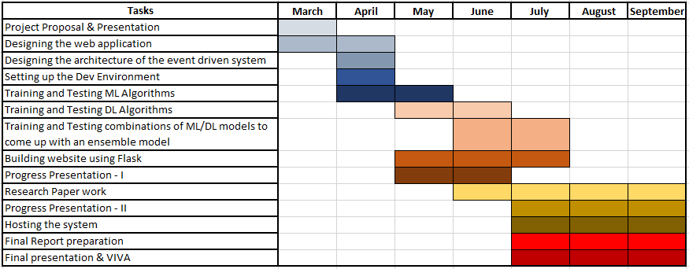
Gannt Chart
IT18071412 | S.W Sajeth Jonathan | 2021-085 10.03.2021

Slide 33
References
​[1] S. N. P. N.Badadhe, "An Efficient Approach To Detecting Phishing A Web Using K-Means And Naïve-Bayes Algorithms With Results.," International Journal of Advanced Research in Computer Engineering & Technology (IJARCET, vol. 3, no. 5, p. 1, 2014.
​[2] R. K. S. B. a. S. S. F. Sadique, "An Automated Framework for Real-time Phishing URL Detection," in 10th Annual Computing and Communication Workshop and Conference (CCWC), Las Vegas, NV, USA, 2020.
[3] ​"APWG Trend Report," 2020. [Online]. Available: https://docs.apwg.org/reports/apwg_trends_report_q4_2020.pdf. [Accessed 25 February 2020].
​[4] W. F. S. S.-G. M. S. E. Benavides, "Classification of Phishing Attack Solutions by Employing Deep Learning Techniques: A Systematic Literature Review," Research Gate, 2020.
​[5]Y. F. Z. Y. Y. W. W. T. Z. P. Yi, "Web Phishing Detection Using a Deep Learning Framework," Wireless Communications and Mobile Computing, vol. 2018, 2018.

Slide 34
References
​[6] Q. K. J. N. M. K. R. S. M. W. W. Wei, "Accurate and fast URL phishing detector: A convolutional neural network approach," Computer Networks, vol. 178, 2020.
​[7] B. J. S. R. V.M Yazhmozhi, "Anti-phishing System using LSTM and CNN," in IEEE International Conference for Innovation in Technology (INOCON), Bengaluru, 2020.
​[8] R. I. J. Ispahany, "Detecting Malicious Urls of COVID-19 Pandemic Using ML Techniques," 2020.
[9] ​N. K. L. S. S. M. a. Y. S. A. Makkar, "An Intelligent Phishing Detection Scheme Using Machine Learning," in Sixth International Conference on Mathematics and Computing, Advances in Intelligent Systems and Computing , Singapore, 2021.
[10] M. Z. X. L. A. R. J. Z. J. K. K. A.Basit, "A comprehensive survey of AI-enabled phishing attacks detection techniques," Springer, 2020. [11] I. M. M. A. R. A. H. L. N. S. a. A. A. G. Mohammad Saiful, "Detecting Malicious URLs Using Lexical," in University of New Brunswick, Fredericton, NB, Canada, Fredericton, 2016. [12] S. S. Vishal A. Kharde, "Sentiment Analysis of Twitter Data: A Survey of Techniques," International Journal of Computer Applications (0975 – 8887), vol. Volume 139, no. 11, p. 15, 2016. [13] E. B. O. D. B. D. Ozgur Koray Sahingoz, "Machine learning based phishing detection from URLs," Expert Systems With Applications, 2019

Slide 35
Wishvajith B.L.D.V. IT18032666
10.03.2021

Slide 36
Introduction
IT18032666 | Wishvajith B.L.D.V. | 2021-085 10.03.2021

Slide 37
Background
Traditional Models
• There are many established solutions to determine if the website the clients/ users are trying to access is malicious or not.
• Almost all these use blacklisting or user feedback /submission mechanisms. [1]
• Results in inefficiency and inaccurate predictions.
IT18032666 | Wishvajith B.L.D.V. | 2021-085 10.03.2021
Notes:
Vijay Kotu, Bala Deshpande PhD, in Predictive Analytics and Data Mining, 2015 .3.4 Ensemble Modeling
Ensemble modeling is a process where multiple diverse models are created to predict an outcome, either by using many different modeling algorithms or using different training data sets.

Slide 38
Background
Machine Learning Models
To counter these issues with traditional models,
many researches has been carried out using machine learning approaches. [2],[3],[4]
IT18032666 | Wishvajith B.L.D.V. | 2021-085 10.03.2021
Notes:
Vijay Kotu, Bala Deshpande PhD, in Predictive Analytics and Data Mining, 2015 .3.4 Ensemble Modeling
Ensemble modeling is a process where multiple diverse models are created to predict an outcome, either by using many different modeling algorithms or using different training data sets.

Slide 39
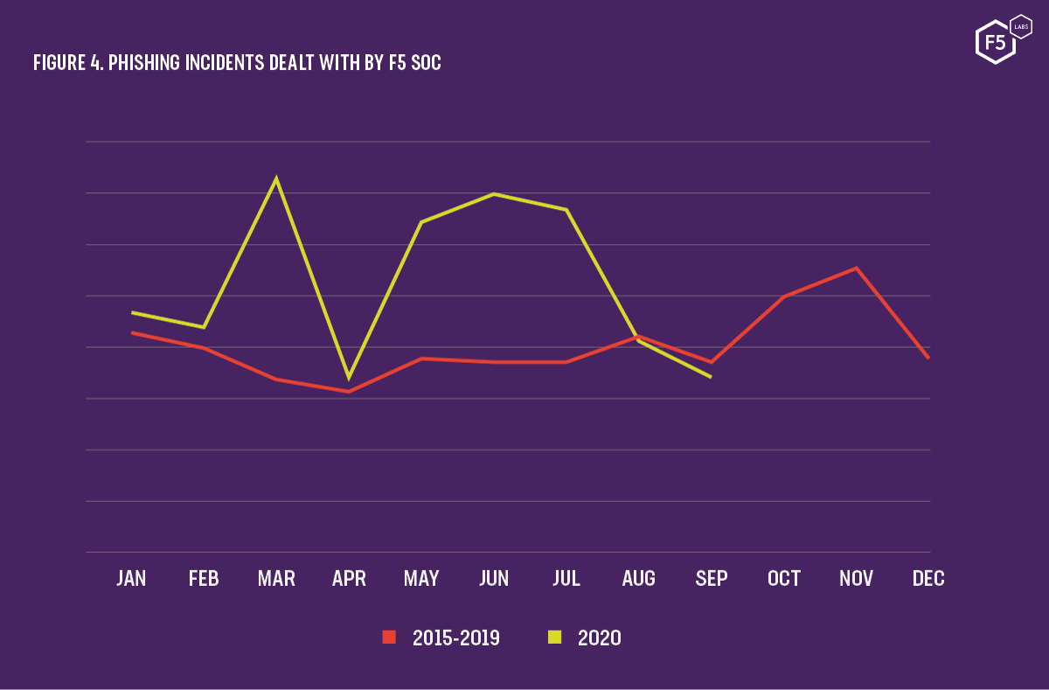
Research Gap
No solution to address the sudden spikes in malicious URLs right after an event / major incident happens.
[6]
IT18032666 | Wishvajith B.L.D.V. | 2021-085 10.03.2021
Notes:
http://cs229.stanford.edu/proj2012/ChongLiu-MaliciousURLDetection.pdf [2]
https://arxiv.org/pdf/1009.2275v1.pdf [3]
https://escholarship.org/uc/item/4q3611mk#figure.caption.56 [4]

Slide 40
Research Gap
Almost all the existing ML solutions do not cover at least one aspect ;
time efficiency, scalability, user friendliness or accuracy.
IT18032666 | Wishvajith B.L.D.V. | 2021-085 10.03.2021
Notes:
http://cs229.stanford.edu/proj2012/ChongLiu-MaliciousURLDetection.pdf [2]
https://arxiv.org/pdf/1009.2275v1.pdf [3]
https://escholarship.org/uc/item/4q3611mk#figure.caption.56 [4]

Slide 41
Research Gap
Papers | Scalability | Accuracy | Classification of URLs | High rate of detection/efficiency | Ability to sort through keywords / Events | Classification of Scenarios
Research A [1]
Research B [2]
Research C [3]
Proposed Solution
IT18032666 | Wishvajith B.L.D.V. | 2021-085 10.03.2021
Notes:
[1] I. M. M. A. R. A. H. L. N. S. a. A. A. G. Mohammad Saiful, "Detecting Malicious URLs Using Lexical," in University of New Brunswick, Fredericton, NB, Canada, Fredericton, 2016.
[2] S. S. Vishal A. Kharde, "Sentiment Analysis of Twitter Data: A Survey of Techniques," International Journal of Computer Applications (0975 – 8887), vol. Volume 139, no. 11, p. 15, 2016.
[3] E. B. O. D. B. D. Ozgur Koray Sahingoz, "Machine learning based phishing detection from URLs," Expert Systems With Applications, 2019.

Slide 42
Research Questions
How to build a solution which has the capability of finding malicious URLs given a scenario unlike the traditional ML models?
How to populate keywords from user inputs?
How to match the populated keywords with URLs?
IT18032666 | Wishvajith B.L.D.V. | 2021-085 10.03.2021
Notes:
Vijay Kotu, Bala Deshpande PhD, in Predictive Analytics and Data Mining, 2015 .3.4 Ensemble Modeling
Ensemble modeling is a process where multiple diverse models are created to predict an outcome, either by using many different modeling algorithms or using different training data sets.

Slide 43
Specific and Sub Objectives
Main Objective
• make use of user inputted keywords and match them with current trends/events to aid with identifying potential malicious URLs.
In order to achieve this,
1.Identify an efficient NLP strategy to populate keywords from user inputs.
2.Build a model to aggregate with online sources for matching URLs for given keywords.
3.Co relate the populated keywords with malicious URLs.
IT18032666 | Wishvajith B.L.D.V. | 2021-085 10.03.2021
Notes:
Vijay Kotu, Bala Deshpande PhD, in Predictive Analytics and Data Mining, 2015 .3.4 Ensemble Modeling
Ensemble modeling is a process where multiple diverse models are created to predict an outcome, either by using many different modeling algorithms or using different training data sets.

Slide 44
Methodology
IT18032666 | Wishvajith B.L.D.V. | 2021-085 10.03.2021

Slide 45
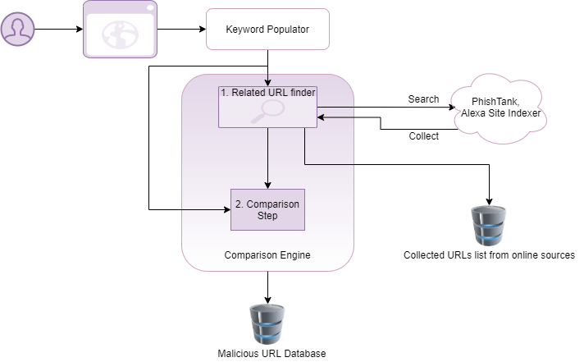
System Diagram
IT18032666 | Wishvajith B.L.D.V. | 2021-085 10.03.2021
Notes:
http://cs229.stanford.edu/proj2012/ChongLiu-MaliciousURLDetection.pdf [2]
https://arxiv.org/pdf/1009.2275v1.pdf [3]
https://escholarship.org/uc/item/4q3611mk#figure.caption.56 [4]

Slide 46
Methodology
Populating Keywords
Keyword Populator
•User inputted keywords will be populated with similar suggestive keywords.
•Preprocessed template keywords from core system will be leveraged.
•Model will use a word level Recurrent Neural Network (RNN) to generate keyword queries.
•To train the model, sample set of keywords/search queries will be prepared through WooRank’s API.
IT18032666 | Wishvajith B.L.D.V. | 2021-085 10.03.2021
Notes:
http://cs229.stanford.edu/proj2012/ChongLiu-MaliciousURLDetection.pdf [2]
https://arxiv.org/pdf/1009.2275v1.pdf [3]
https://escholarship.org/uc/item/4q3611mk#figure.caption.56 [4]

Slide 47
Methodology
Aggregating Sources for URL Collection
Related URL finder
•Part of the comparison engine
•Will aggregate with online sources (PhishTank, Alexa site indexer) for URL collection
•Collected URLs will be stored as a list for processing
IT18032666 | Wishvajith B.L.D.V. | 2021-085 10.03.2021
Notes:
http://cs229.stanford.edu/proj2012/ChongLiu-MaliciousURLDetection.pdf [2]
https://arxiv.org/pdf/1009.2275v1.pdf [3]
https://escholarship.org/uc/item/4q3611mk#figure.caption.56 [4]

Slide 48
Methodology
Correlating the Populated Keywords with URLs.
Comparison Engine
•Responsible for comparing and matching up user inputs with premade template keywords and populated keywords.
•Then further matching them with collected URLs list (from the related URL finder.) to find if a URL is registered with a malicious intent.
•For example – User input = Covid19
The model search for obfuscated variants like C0vid19, CovidVirus, Cov1d
•If a URL is identified as malicious, it will be forwarded to and stored in the malicious URL database.
IT18032666 | Wishvajith B.L.D.V. | 2021-085 10.03.2021
Notes:
http://cs229.stanford.edu/proj2012/ChongLiu-MaliciousURLDetection.pdf [2]
https://arxiv.org/pdf/1009.2275v1.pdf [3]
https://escholarship.org/uc/item/4q3611mk#figure.caption.56 [4]

Slide 49

Technologies / Tools Used
IT18032666 | Wishvajith B.L.D.V. | 2021-085 10.03.2021
Notes:
http://cs229.stanford.edu/proj2012/ChongLiu-MaliciousURLDetection.pdf [2]
https://arxiv.org/pdf/1009.2275v1.pdf [3]
https://escholarship.org/uc/item/4q3611mk#figure.caption.56 [4]

Slide 50
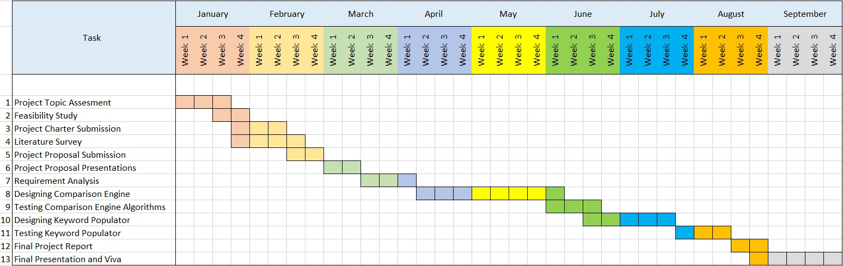
Gantt Chart
IT18032666 | Wishvajith B.L.D.V. | 2021-085 10.03.2021
Notes:
http://cs229.stanford.edu/proj2012/ChongLiu-MaliciousURLDetection.pdf [2]
https://arxiv.org/pdf/1009.2275v1.pdf [3]
https://escholarship.org/uc/item/4q3611mk#figure.caption.56 [4]

Slide 51
References
[1] C. G. J. M. V. P. a. D. S. Kurt Thomas, "Design and evaluation of a real-time url spam filtering service," in IEEE Symposium on. IEEE, 2011.
[2] I. M. M. A. R. A. H. L. N. S. a. A. A. G. Mohammad Saiful, "Detecting Malicious URLs Using Lexical," in University of New Brunswick, Fredericton, NB, Canada, Fredericton, 2016.
[3] S. S. Vishal A. Kharde, "Sentiment Analysis of Twitter Data: A Survey of Techniques," International Journal of Computer Applications (0975 – 8887), vol. Volume 139, no. 11, p. 15, 2016.
[4] E. B. O. D. B. D. Ozgur Koray Sahingoz, "Machine learning based phishing detection from URLs," Expert Systems With Applications, 2019.
[5] D. R. &. P. J. B. Patil, "URLs detection using decision tree classifiers and majority voting technique," Cybernetics and Information Technologies, vol. 18, no. 1, pp. 11-29, 2018.
[6] D. Warburton, "2020 Phishing and Fraud Report," F5 Labs, [Online]. Available: https://www.f5.com/labs/articles/threat-intelligence/2020-phishing-and-fraud-report. [Accessed 21 02 2021].
IT18032666 | Wishvajith B.L.D.V. | 2021-085 10.03.2021
Notes:
http://cs229.stanford.edu/proj2012/ChongLiu-MaliciousURLDetection.pdf [2]
https://arxiv.org/pdf/1009.2275v1.pdf [3]
https://escholarship.org/uc/item/4q3611mk#figure.caption.56 [4]

Slide 52
Ramanayaka A. M IT18021912
IT18021912 | Ramanayaka A. M | 2021-085 10.03.2021

Slide 53
Introduction
IT18021912 | Ramanayaka A. M | 2021-085 10.03.2021

Slide 54
Background
People relying more on web services.[1]
More malicious activities occur with the increase in the use of web services among people therefore more security concerns.[1]
Phishing incidents increase every year, statistics show that the number of phishing incidents were known to have increased by 15% from 2019 to 2020.[2]
Scenario categorization for phishing detection and URL feature identification & classification.[4] [5] [6]
IT18021912 | Ramanayaka A. M | 2021-085 10.03.2021

Slide 55
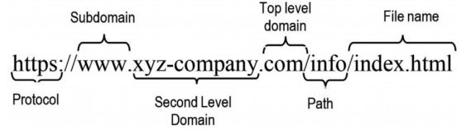
Background
Cyber criminals use trending topics for their phishing emails
Attackers create fraudulent websites similar to popular websites.[3]
Knowing components of the URL is one of the key factors for catching malicious URLs.[3]
[3]
IT18021912 | Ramanayaka A. M | 2021-085 10.03.2021

Slide 56
Research Gap
Papers | Scalability | Accuracy | Classification of URLs | High rate of detection/efficiency | Ability to sort through keywords / Events | Classification of Scenarios
Research A [1]
Research B [2]
Research C [3]
Proposed Solution
IT18021912 | Ramanayaka A.M. | 2021-085 10.03.2021
Notes:
[1] I. M. M. A. R. A. H. L. N. S. a. A. A. G. Mohammad Saiful, "Detecting Malicious URLs Using Lexical," in University of New Brunswick, Fredericton, NB, Canada, Fredericton, 2016.
[2] S. S. Vishal A. Kharde, "Sentiment Analysis of Twitter Data: A Survey of Techniques," International Journal of Computer Applications (0975 – 8887), vol. Volume 139, no. 11, p. 15, 2016.
[3] E. B. O. D. B. D. Ozgur Koray Sahingoz, "Machine learning based phishing detection from URLs," Expert Systems With Applications, 2019.

Slide 57
Research Question
How can the feature reduction be done to build an ensemble model that will be efficient enough to detect phishing URLs with better scalability and speed?
IT18021912 | Ramanayaka A. M | 2021-085 10.03.2021

Slide 58
Specific & Sub Objectives
Specific Objectives
Sub Objectives
URL Feature Reduction
Scenario Categorization
URL Feature Classification
URL Feature Analysis
URL Feature reduction techniques
IT18021912 | Ramanayaka A. M | 2021-085 10.03.2021

Slide 59
Research Methodology
IT18021912 | Ramanayaka A. M | 2021-085 10.03.2021

Slide 60
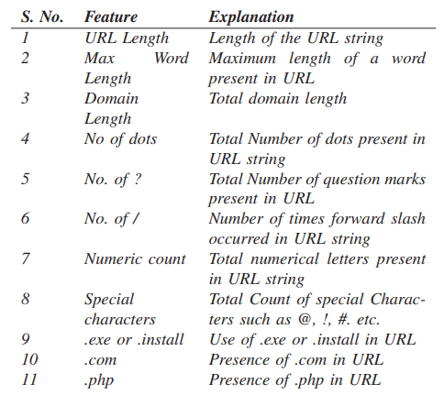
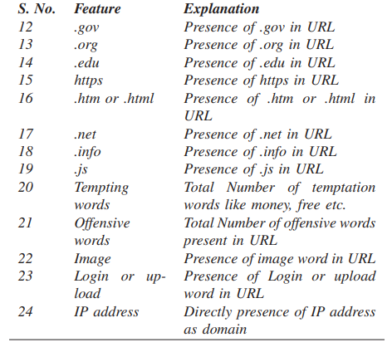
URL Feature Extraction [9]
IT18021912 | Ramanayaka A. M | 2021-085 10.03.2021

Slide 61
Technologies & Techniques
Feature Reduction Techniques [10]
Missing Value Ratio
Low Variance Filter
High Correlation Filter
Random Forest
Backward Feature Elimination
Forward Feature Selection
IT18021912 | Ramanayaka A. M | 2021-085 10.03.2021

Slide 62
References
[1] | Y. G. F. Z. Y. Y. W. W. a. T. Z. Ping Yi, “Web Phishing Detection Using a Deep Learning Framework,” Hindawi, vol. 2018, p. 9, 2018.
[2] | D. Warburton, “F5,” F5 Labs - Application Threat Intelligence, 11 November 2020. [Online]. Available: https://www.f5.com/labs/articles/threat-intelligence/2020-phishing-and-fraud-report#:~:text=The%20number%20of%20phishing%20incidents,at%20the%20access%20control%20layer..
[3] | E. B. O. D. B. D. Ozgur Koray Sahingoz, “Machine learning based phishing detection from URLs,” Elsevier, p. 14, 2018.
[4] | C. L. S. C. H. H. Doyen Sahoo, “Malicious URL Detection using Machine Learning: A Survey,” 2019.
[5] | “19 Examples of Common Phishing Emails…And How to Avoid Them,” 2021 Terranova Worldwide Corporation, [Online]. Available: https://terranovasecurity.com/top-examples-of-phishing-emails/.
[6] | R. A. Grimes, “14 real-world phishing examples — and how to recognize them,” CSO Online, 9 April 2020. [Online]. Available: https://www.csoonline.com/article/3235520/15-real-world-phishing-examples-and-how-to-recognize-them.html#.
[7] | A. O. A. Andronicus A. Akinyelu, “Classification of Phishing Email Using Random Forest Machine,” Hindawi, vol. 2014, p. 7, 2014.
[8] | J. I. &. R. Islam, “Detecting Malicious Urls of COVID-19 Pandemic,” p. 17, 2020.
[9] | B. S. Yogendra Kumar, “A lightweight machine learning based security,” in International Conference on Communication Systems & Networks (COMSNETS), 2021.
[10] | P. Sharma, “The Ultimate Guide to 12 Dimensionality Reduction Techniques (with Python codes),” Analytics Vidhya, 27 August 2018. [Online]. Available: https://www.analyticsvidhya.com/blog/2018/08/dimensionality-reduction-techniques-python/.
IT18021912 | Ramanayaka A. M | 2021-085 10.03.2021

Slide 63
Renu Harshatha A. IT18034400
IT18034400 | Renu Harshatha A. | 2021-085 10.03.2021

Slide 64
Introduction
IT18034400 | Renu Harshatha A. | 2021-085 10.03.2021

Slide 65
Background
From January to April 2020, some 907,000 spam messages, 737 incidents related to malware and 48,000 malicious URLs - all related to Covid-19 were detected [5]
A campaign targeting businesses could see cybercriminals sending out documents that are made to look like government advice on dealing with Brexit which in fact download malware.[7]
As of April 2020, roughly 60,000 include COVID-19 related malicious attachments or malicious URLs. [6]
IT18034400 | Renu Harshatha A. | 2021-085 10.03.2021
Notes:
https://www.rte.ie/news/newslens/2020/0804/1157249-cybercrime/ [5]
https://www.microsoft.com/security/blog/2020/04/08/microsoft-shares-new-threat-intelligence-security-guidance-during-global-crisis/ [6]
https://www.itpro.co.uk/security/32560/spike-in-brexit-themed-phishing-attacks-expected-once-withdrawal-agreement-is [7]

Slide 66
Research Gap
Papers | Scalability | Accuracy | Classification of URLs | High rate of detection/efficiency | Ability to sort through keywords / Events | Classification of Scenarios
Research A [2]
Research B [3]
Research C [4]
Proposed Solution
IT18034400 Renu Harshatha A.. | 2021-085 10.03.2021

Slide 67

Background
Although there are systems to detect the malicious URLs, most of the researches’ primary focus is accuracy.
Increase in cyber-attacks
IT18034400 | Renu Harshatha A. | 2021-085 10.03.2021

Slide 68
Background
What is Scaling?
Why do we need Scaling in our Research?
IT18034400 | Renu Harshatha A. | 2021-085 10.03.2021

Slide 69
Background
Time taken to train a model is high, and the models tend to be big which does not fit in the memory of the training device.
Scaling the system with devices with more processing power is expensive.
IT18034400 | Renu Harshatha A. | 2021-085 10.03.2021

Slide 70
Research Questions
How is our system going scale when there is more URLs to scan?
How is the system going to adapt when there’s more keywords?
IT18034400 | Renu Harshatha A. | 2021-085 10.03.2021

Slide 71
Specific and Sub Objectives
Main Objective:
Integrate Nomad to scale the proposed system.
Create a browser extension
Sub Objectives:
Containerize the proposed solution
Analyse cost on deploying the infrastructure
IT18034400 | Renu Harshatha A. | 2021-085 10.03.2021

Slide 72
Research Methodology
IT18034400 | Renu Harshatha A. | 2021-085 10.03.2021

Slide 73
 | Nomad | Kubernetes
Simplicity | Architecturally much simpler. Distributed, highly available and operationally simple. | Operationally complex to setup
Flexible Workload Support | Supports virtualised, containerised and standalone | Focused on Docker
Consistent Deployment | Can be deployed in local dev, productions, on premises and in clouds. Ease of use across all environments | Installation for production environment is time consuming.
Scalability | Easy to scale apps deployment across multiple data centers, regions and clouds with no complexity. | Significant challenges of managing the system at scale.
IT18034400 | Renu Harshatha A. | 2021-085 10.03.2021
Notes:
[1] https://www.nomadproject.io/docs/nomad-vs-kubernetes

Slide 74
IT18034400 | Renu Harshatha A. | 2021-085 10.03.2021
Notes:
[1] https://www.nomadproject.io/docs/nomad-vs-kubernetes

Slide 75
IT18034400 | Renu Harshatha A. | 2021-085 10.03.2021
Notes:
[1] https://www.nomadproject.io/docs/nomad-vs-kubernetes

Slide 76

Technologies/ Techniques
IT18034400 | Renu Harshatha A. | 2021-085 10.03.2021

Slide 77
System, Personnel & Software Requirements
System Requirements
Visual Studio
Microsoft Azure
Jupyter Notebook

Slide 78
System, Personnel & Software Requirements
Functional Requirements
The system shall collect URL data and warn the user when detect as malicious
Non Functional Requirements
Scalability
Accuracy & Efficiency

Slide 79
Work Breakdown Structure WBS
Event-Driven Malicious Extractor
Initiation
Planning
Design
Implementation
Closeout
Creation of Project Charter
Creation of Project Proposal
Choosing a methodology for scaling the system
Creating a browser extension
Setting up cloud
Wireframes , UI for browser extension
Testing Nomad containerisation with ensemble model
Testing the model’s scalability and accuracy
Testing and Implementing browser extension which also supports mobile devices
Implementing a procedure to Create logs and reports through browser extension
Host the application and run it
Final Presentation
System Design for Scaling the system
IT18034400 | Renu Harshatha A. | 2021-085 10.03.2021

Slide 80
Event-Driven Malicious Extractor
Initiation
Planning
Design
Implementation
Closeout
Creation of Project Charter
Creation of Project Proposal
Choosing a methodology for scaling the system
Creating a browser extension
Setting up cloud
Wireframes , UI for browser extension
Testing Nomad containerisation with ensemble model
Testing the model’s scalability and accuracy
Testing and Implementing browser extension which also supports mobile devices
Implementing a procedure to Create logs and reports through browser extension
Host the application and run it
Final Presentation
System Design for Scaling the system

Slide 81
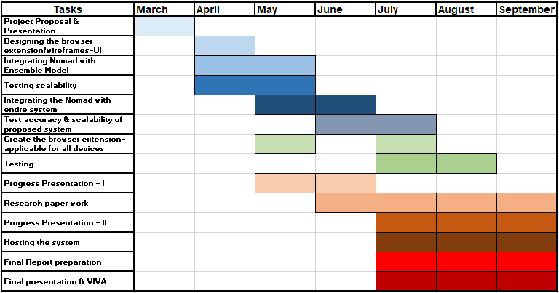
Gannt Chart
IT18034400 | Renu Harshatha A. | 2021-085 10.03.2021

Slide 82
References
[1] nomad. (2021, February 28). Nomad Vs. Kubernetes. Retrieved from nomadproject.io: https://www.nomadproject.io/docs/nomad-vs-kubernetes
[2] I. M. M. A. R. A. H. L. N. S. a. A. A. G. Mohammad Saiful, "Detecting Malicious URLs Using Lexical," in University of New Brunswick, Fredericton, NB, Canada, Fredericton, 2016.
[3] S. S. Vishal A. Kharde, "Sentiment Analysis of Twitter Data: A Survey of Techniques," International Journal of Computer Applications (0975 – 8887), vol. Volume 139, no. 11, p. 15, 2016.
[4] E. B. O. D. B. D. Ozgur Koray Sahingoz, "Machine learning based phishing detection from URLs," Expert Systems With Applications, 2019.
[5] RTE. (2020, August Tuesday). 'Alarming' cybercrime increase during Covid-19 pandemic, says Interpol. Retrieved from RTE: https://www.rte.ie/news/newslens/2020/0804/1157249-cybercrime/
[6] Rob Lefferts. (2020, April 8). Microsoft shares new threat intelligence, security guidance during global crisis. Retrieved from Microsoft : https://www.microsoft.com/security/blog/2020/04/08/microsoft-shares-new-threat-intelligence-security-guidance-during-global-crisis/
[7] expected once withdrawal agreement is finalised: https://www.itpro.co.uk/security/32560/spike-in-brexit-themed-phishing-attacks-expected-once-withdrawal-agreement-is
IT18034400 | Renu Harshatha A. | 2021-085 10.03.2021

Slide 83
Budget
$300 in Azure
Model Training and Testing
Website Deployment
IT18034400 | Renu Harshatha A. | 2021-085 10.03.2021

Slide 84
Commercialization
First Line of Defence for Organisations
Inexpensive
Targeting Small-to-Medium Enterprises
On-prem/Cloud Deployments
IT18034400 | Renu Harshatha A. | 2021-085 10.03.2021

Slide 85
Thanks!

Slide 86
Event-Driven Malicious Extractor
Initiation
Planning
Design
Implementation
Closeout
Creation of Project Charter
Creation of Project Proposal
Choosing a methodology for scaling the system
Creating a browser extension
Setting up cloud
Wireframes , UI for browser extension
Testing Nomad containerisation with ensemble model
Testing the model’s scalability and accuracy
Testing and Implementing browser extension which also supports mobile devices
Implementing a procedure to Create logs and reports through browser extension
Host the application and run it
Final Presentation
System Design for Scaling the system

